Slide 1
Projectile Motion
Projectile motion.
Effect of air resistance on projectile motion.

Slide 2
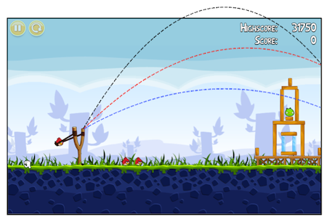
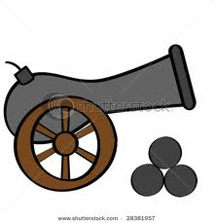
What is a projectile?
Any object that moves through the air or space

Slide 3
First…
Let’s think about objects that move horizontal…

Slide 4
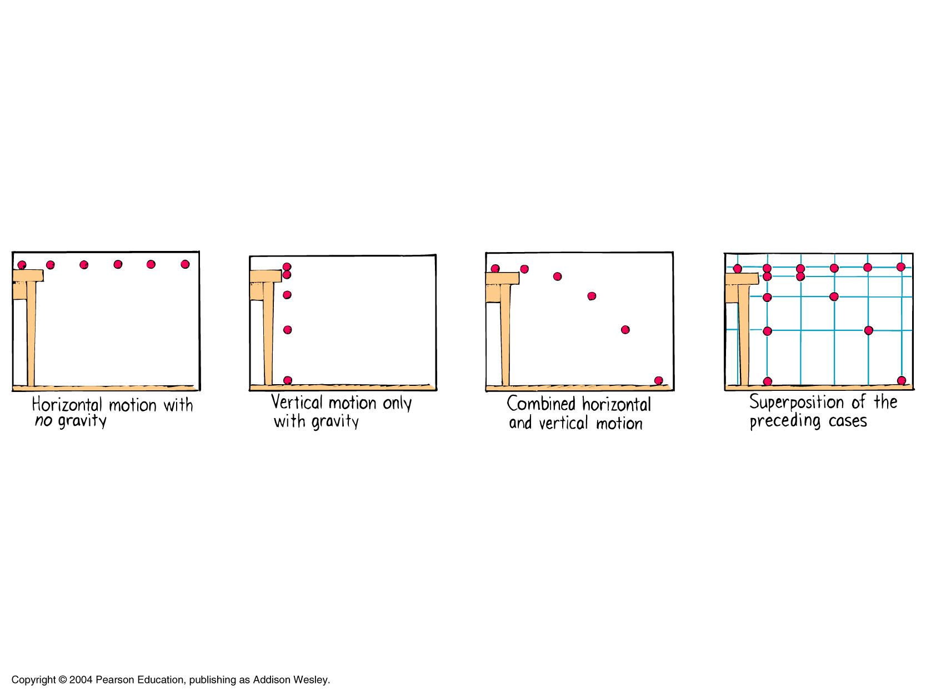
Horizontal Motion
If there were no gravity, an object moving horizontally (in the x-direction) would continue to move in a straight line

Slide 5
Vertical Motion
If an object is dropped vertically (in the y-direction), then gravity causes it to accelerate downwards

Slide 6
Projectile Motion
Projectile motion is a combination of horizontal and vertical motion
In the x-direction, it continues to move at a constant speed, but in the y-direction, it accelerate downwards because of gravity!

Slide 7
Important points..
For a projectile: THE X-VELOCITY IS independent OF THE Y-VELOCITY!!!
The speed in the x-direction doesn’t care what the speed in the y-direction is!

Slide 8
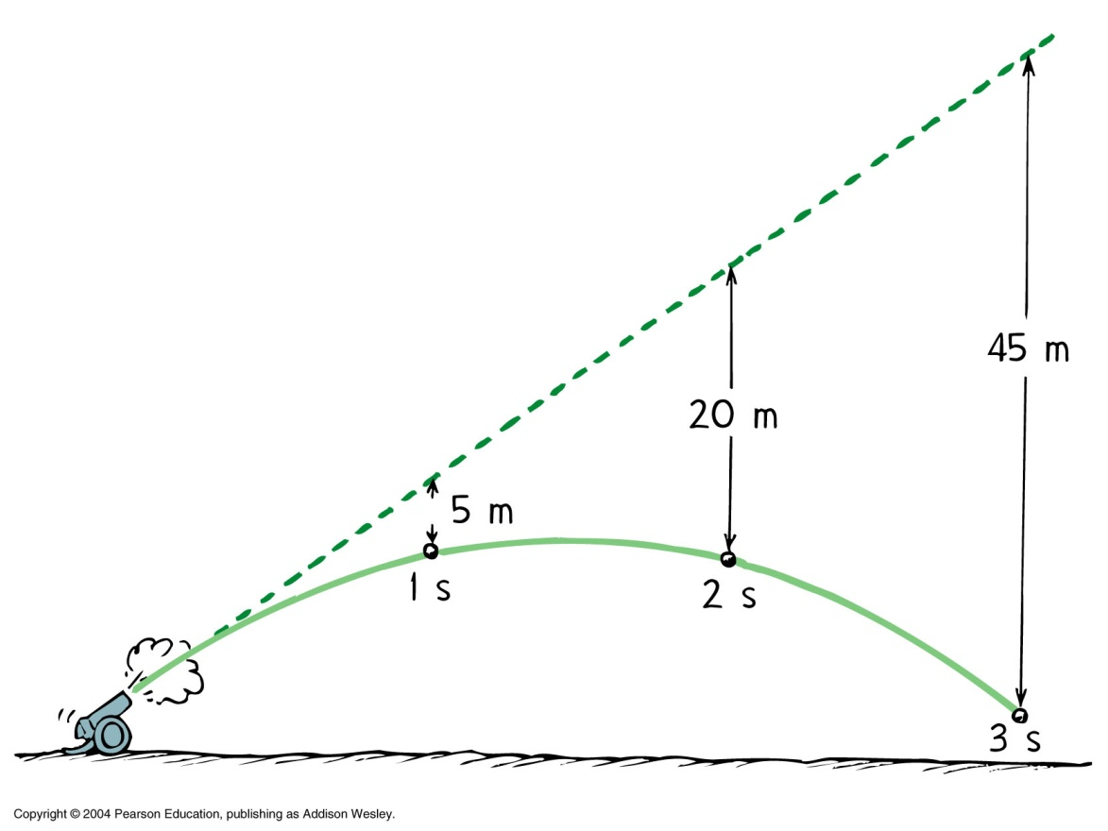
Important points..
Remember that gravity is only pulling in one direction (downwards) and nothing is pulling left or right
If there were no gravity, a projectile would go in a straight line forever:

Slide 9
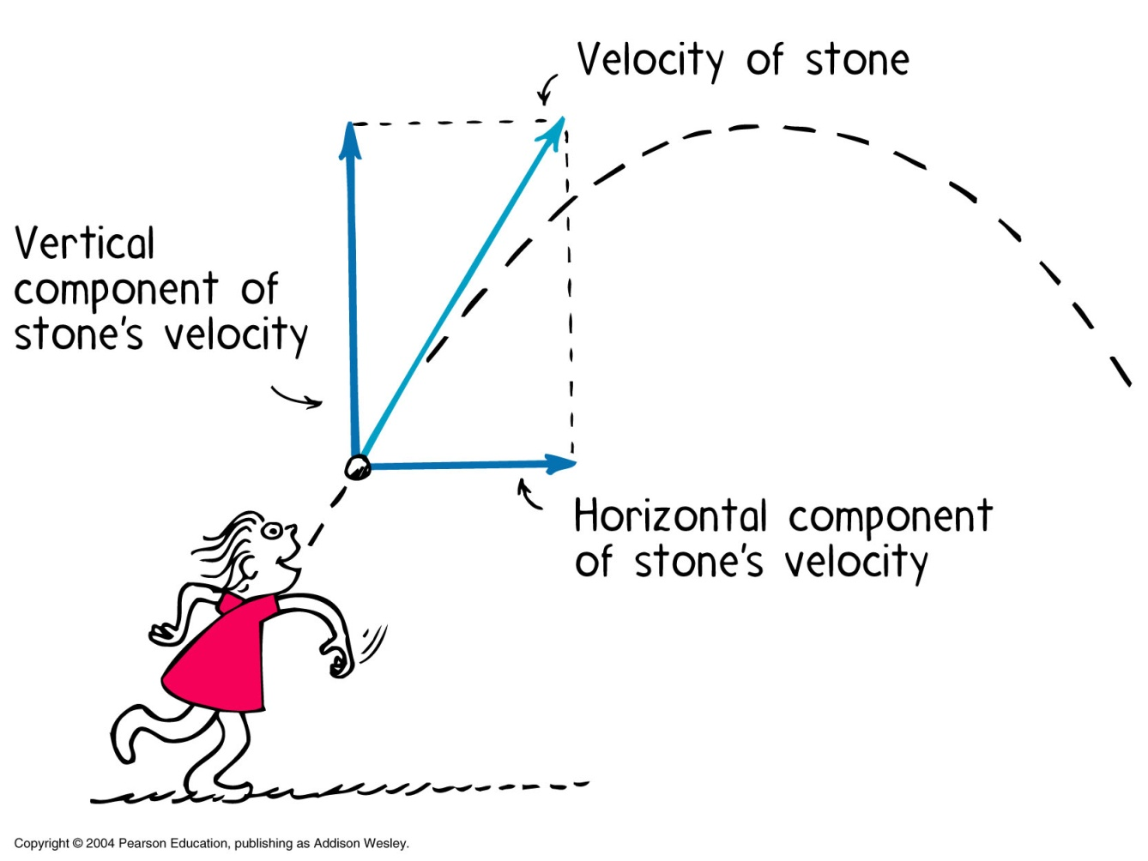
Velocity Vectors
Remember that velocity has a magnitude and direction, so it can be represented using vector.
We can break down the velocity into separate x- and y- components:

Slide 10
Horizontal motion
Ignoring air resistance, no net horizontal force acts on the object.
Object move with uniform velocity
Fnet = 0 therefore acceleration = 0 (F=ma)
Equation related to horizontal motion
Sx = Ux t
Sx=horizontal displacement
Ux=initial horizontal velocity
t= time

Slide 11
Horizontal motion
R=Ux T
R=Range (Max horizontal displacement)
Ux=initial horizontal velocity
T=time of projectile (time projectile spends in the air
R

Slide 12
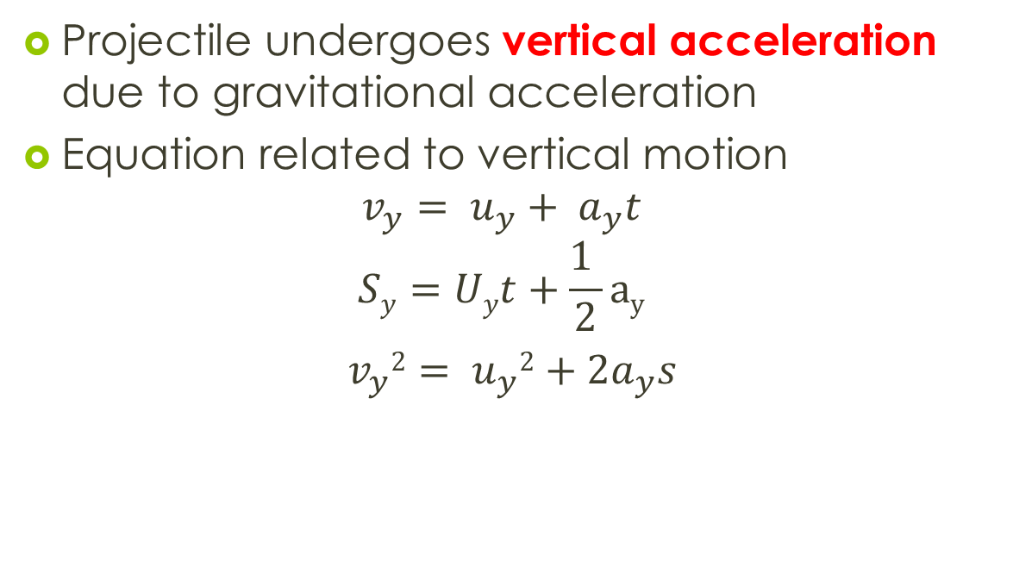
Vertical motion
Projectile undergoes vertical acceleration due to gravitational acceleration
Equation related to vertical motion
$$v_{y}= u_{y}+ a_{y}t$$
$$Sy=Uyt+\frac{1 }{2}ay$$
${ v}_{y}2= u_{y}2+2a_{y}s$

Slide 13
Velocity Vectors
Let’s examine the x and y velocity vectors for a projectile:
Vy is increasing
Vx is uniform

Slide 14
0ms⁻¹
Just like in free-fall:
Velocity in the y-direction decreases on the way up,
and increases on the way down
At the top of the path, the y-velocity is always zero
Velocity on the way up equal velocity on the way down
when you reach the same height
10ms⁻¹
20ms⁻¹
30ms⁻¹
10ms⁻¹
20ms⁻¹
30ms⁻¹

Slide 15
Test yourself…
An airplane is carrying a bomb and traveling with a velocity of 1,100 mph east. If it releases its bomb and continues at that velocity, will the bomb land:
A. Directly underneath the plane
B. Behind the plane
C. Ahead of the plane

Slide 16
Answer!
If they’re going at the same x-velocity, it will land directly beneath the plane!

Slide 17
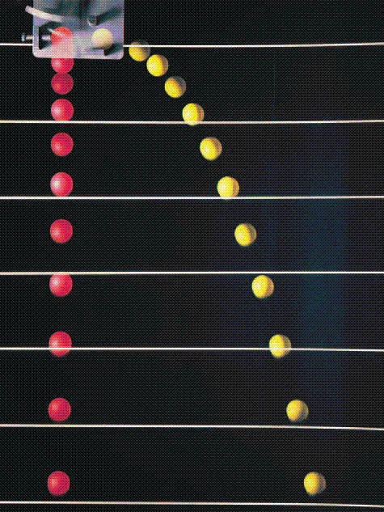
Test yourself….
Suppose two balls released from the same height: one is dropped from rest, and the other is thrown horizontally. Which will hit the ground first? Why?
They will hit at the same time, because they are both being pulled by gravity at the same rate! Only one will have a greater x-range.

Slide 18
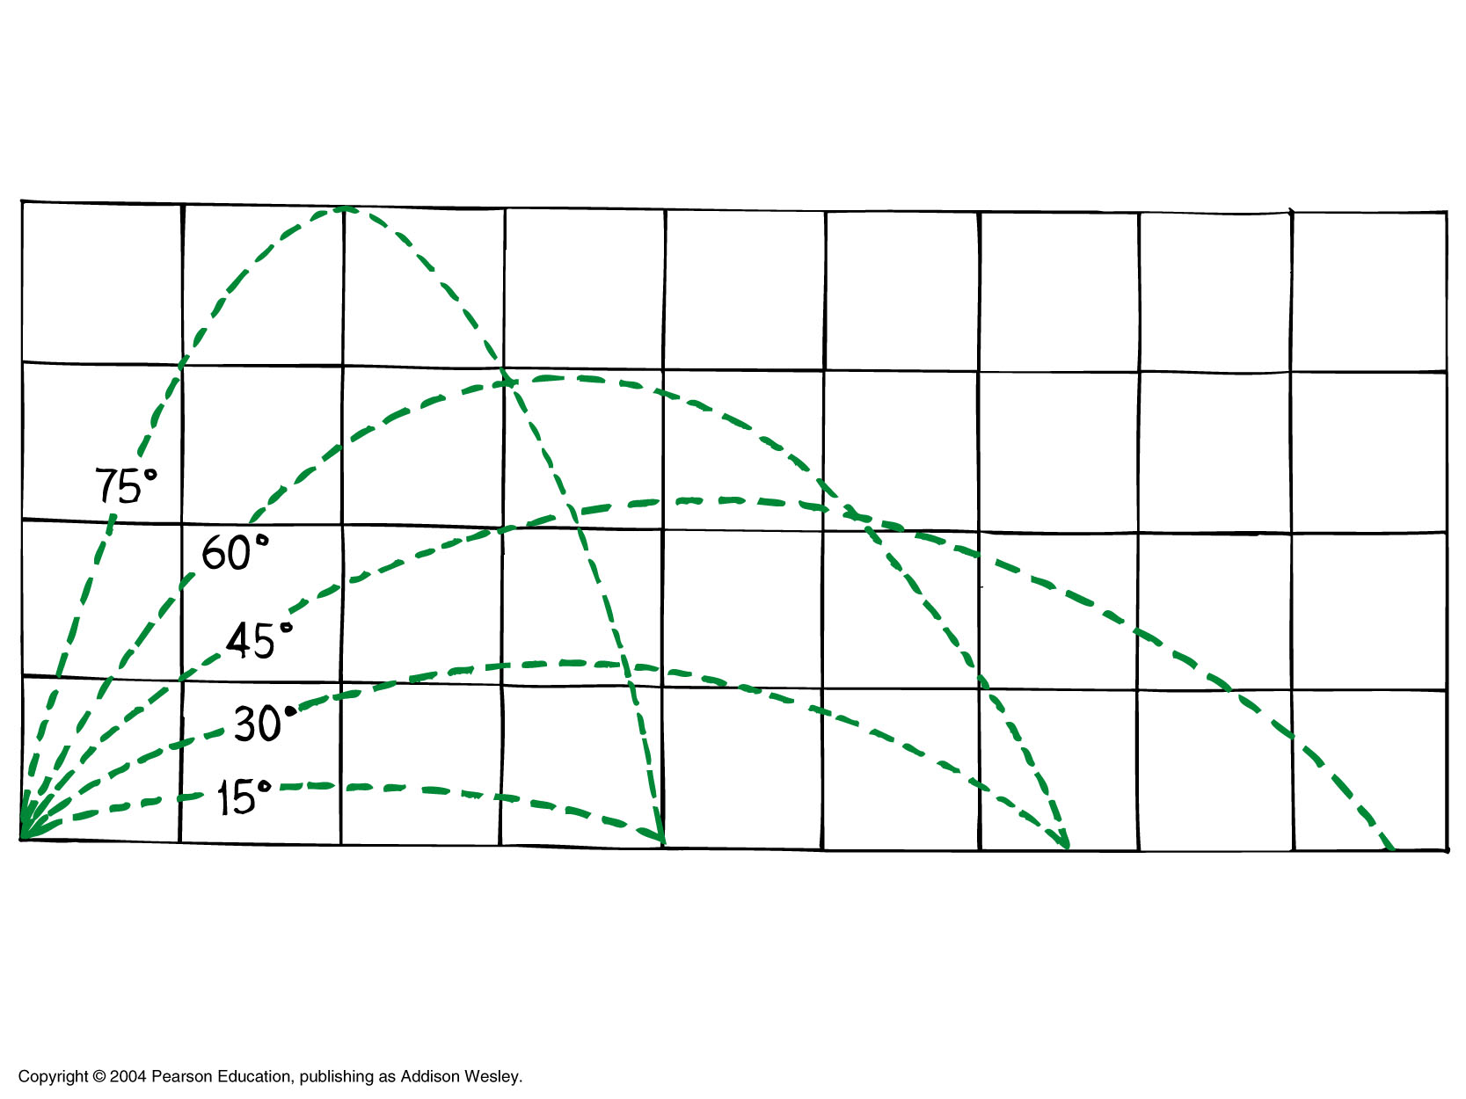
Maximum range
Range is the horizontal displacement
Range depend on:
The angle that the projectile is launched at.
The velocity it is launched at.

Slide 19

BE BACK AFTER SHORT VIDEO BREAK…..
http://www.youtube.com/watch?v=zEHLN06NkiY

Slide 20
Example 1
A golf ball of mass 45g is hit horizontally from the top of a 40.0m high cliff with a speed of 25ms-1.Assuming an acceleration due to gravity of 9.80ms-2 and ignoring air resistance, calculate
The time that the ball takes to land
The distance that the ball travels from the base of the cliff
The velocity of the ball as it lands
The net force acting on the ball at points A and B
The acceleration of the ball at point A and B
The displacement of the ball after 2.00s

Slide 21
Example 2
A 65 kg athlete in a long jump event leaps with a velocity of 7.50 ms⁻¹ at 30.0° to the horizontal. Treating the athlete as a point mass, ignoring air resistance, and using g as 9.80 ms⁻², calculate:
the horizontal component of the initial velocity
the vertical component of the initial velocity
the velocity when at the highest point
the maximum height reached by the athlete
the total time for which the athlete is in the air
the horizontal distance travelled by the athlete’s centre of mass (assuming that it returns to its original height)
the athlete’s acceleration at the highest point of the jump

Slide 22

That’s all for today..
SEE you in lab session tomorrow
p/s : Long holiday on the way …HOORAY!!!!!!!(Thursday – Monday)
Don’t forget your homework's… ☺
www.youtube.com/watch?v=zOzsjEmjjHs

Slide 23
Effect of air resistance on projectile motion
Path of projectile if no air resistance (parabolic)
Path if air resistance is present

Slide 24
Effect of air resistance on projectile motion
t11
t21
Time taken for its upward path is shorter than time taken for its downward path
T1<T2
WHY???..

Slide 25
Effect of air resistance on projectile motion
t11
t21
The net force is less on the way down.
The smaller acceleration means a greater time taken to cover the same distance
Object moving up
Object moving down
Air resistance
mg
Air resistance
mg
Note : Air resistance is always opposite to motion

Slide 26
Effect of air resistance on projectile motion
In conclusion, projectile motion in air
a)reduce its range
b)reduce its maximum height
c)increase its angle of descent
Path of projectile if no air resistance (parabolic)
Path if air resistance is present

Slide 27
Effect of air resistance on projectile motion
Factors that effect air resistance
Silhouette Area …bigger the cross sectional area bigger the air resistance
Mass…Smaller the mass, bigger the air resistance
Eg : table tennis ball experience more resistance than shot putt.

